Slide 1

Quick Cash- "Mobile Banking Software"
- A Simple Digital Wallet System

Slide 2

Group Introduction
SL NO. | Group Members | Student ID
01. | Ashraful Islam Tusher | 41230301340
02. | MD Abdulla Al Masum | 41230301349
03. | MD Maruf Sheikh | 41230301333
04. | Mst Ritu Khatun | 41230301350
05. | Mahinul Hasan Mahin | 41230301330
06. | Rubayet Al Ahad | 41230301344
Group- C

Slide 3

Project Introduction
🎯 Objective:
To build a console-based digital wallet application that simulates mobile financial services like Send Money, Cash In, Cash Out, Mobile Recharge, Payment, and Account Management securely using C++.

Slide 4
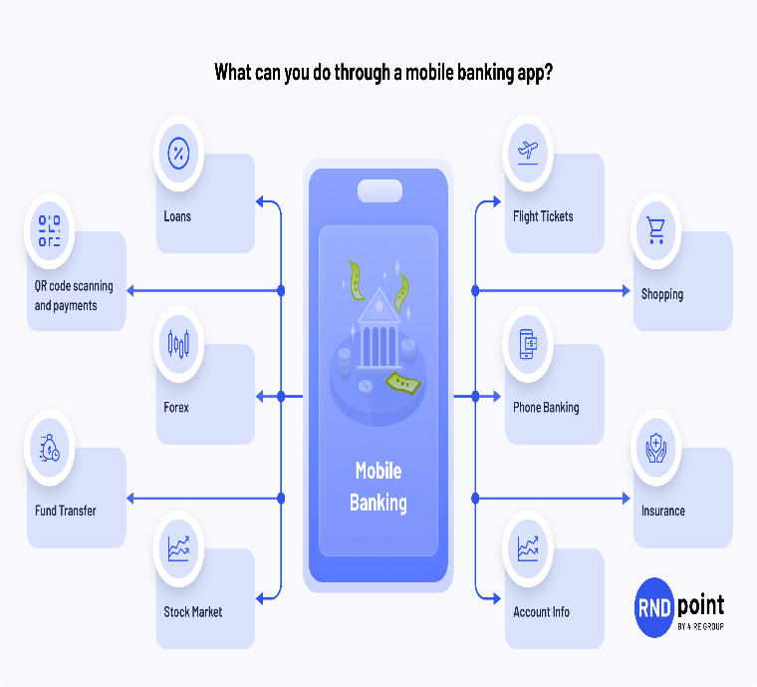
Motivation
In today’s cashless society, mobile wallets play a vital role. This project aims to:
Enhance understanding of OOP, file handling, and data validation.
Simulate the real-world behavior of apps like bKash/Nagad for educational purposes.
Practice secure data handling with PIN hashing, transaction validation, and user authentication.

Slide 5
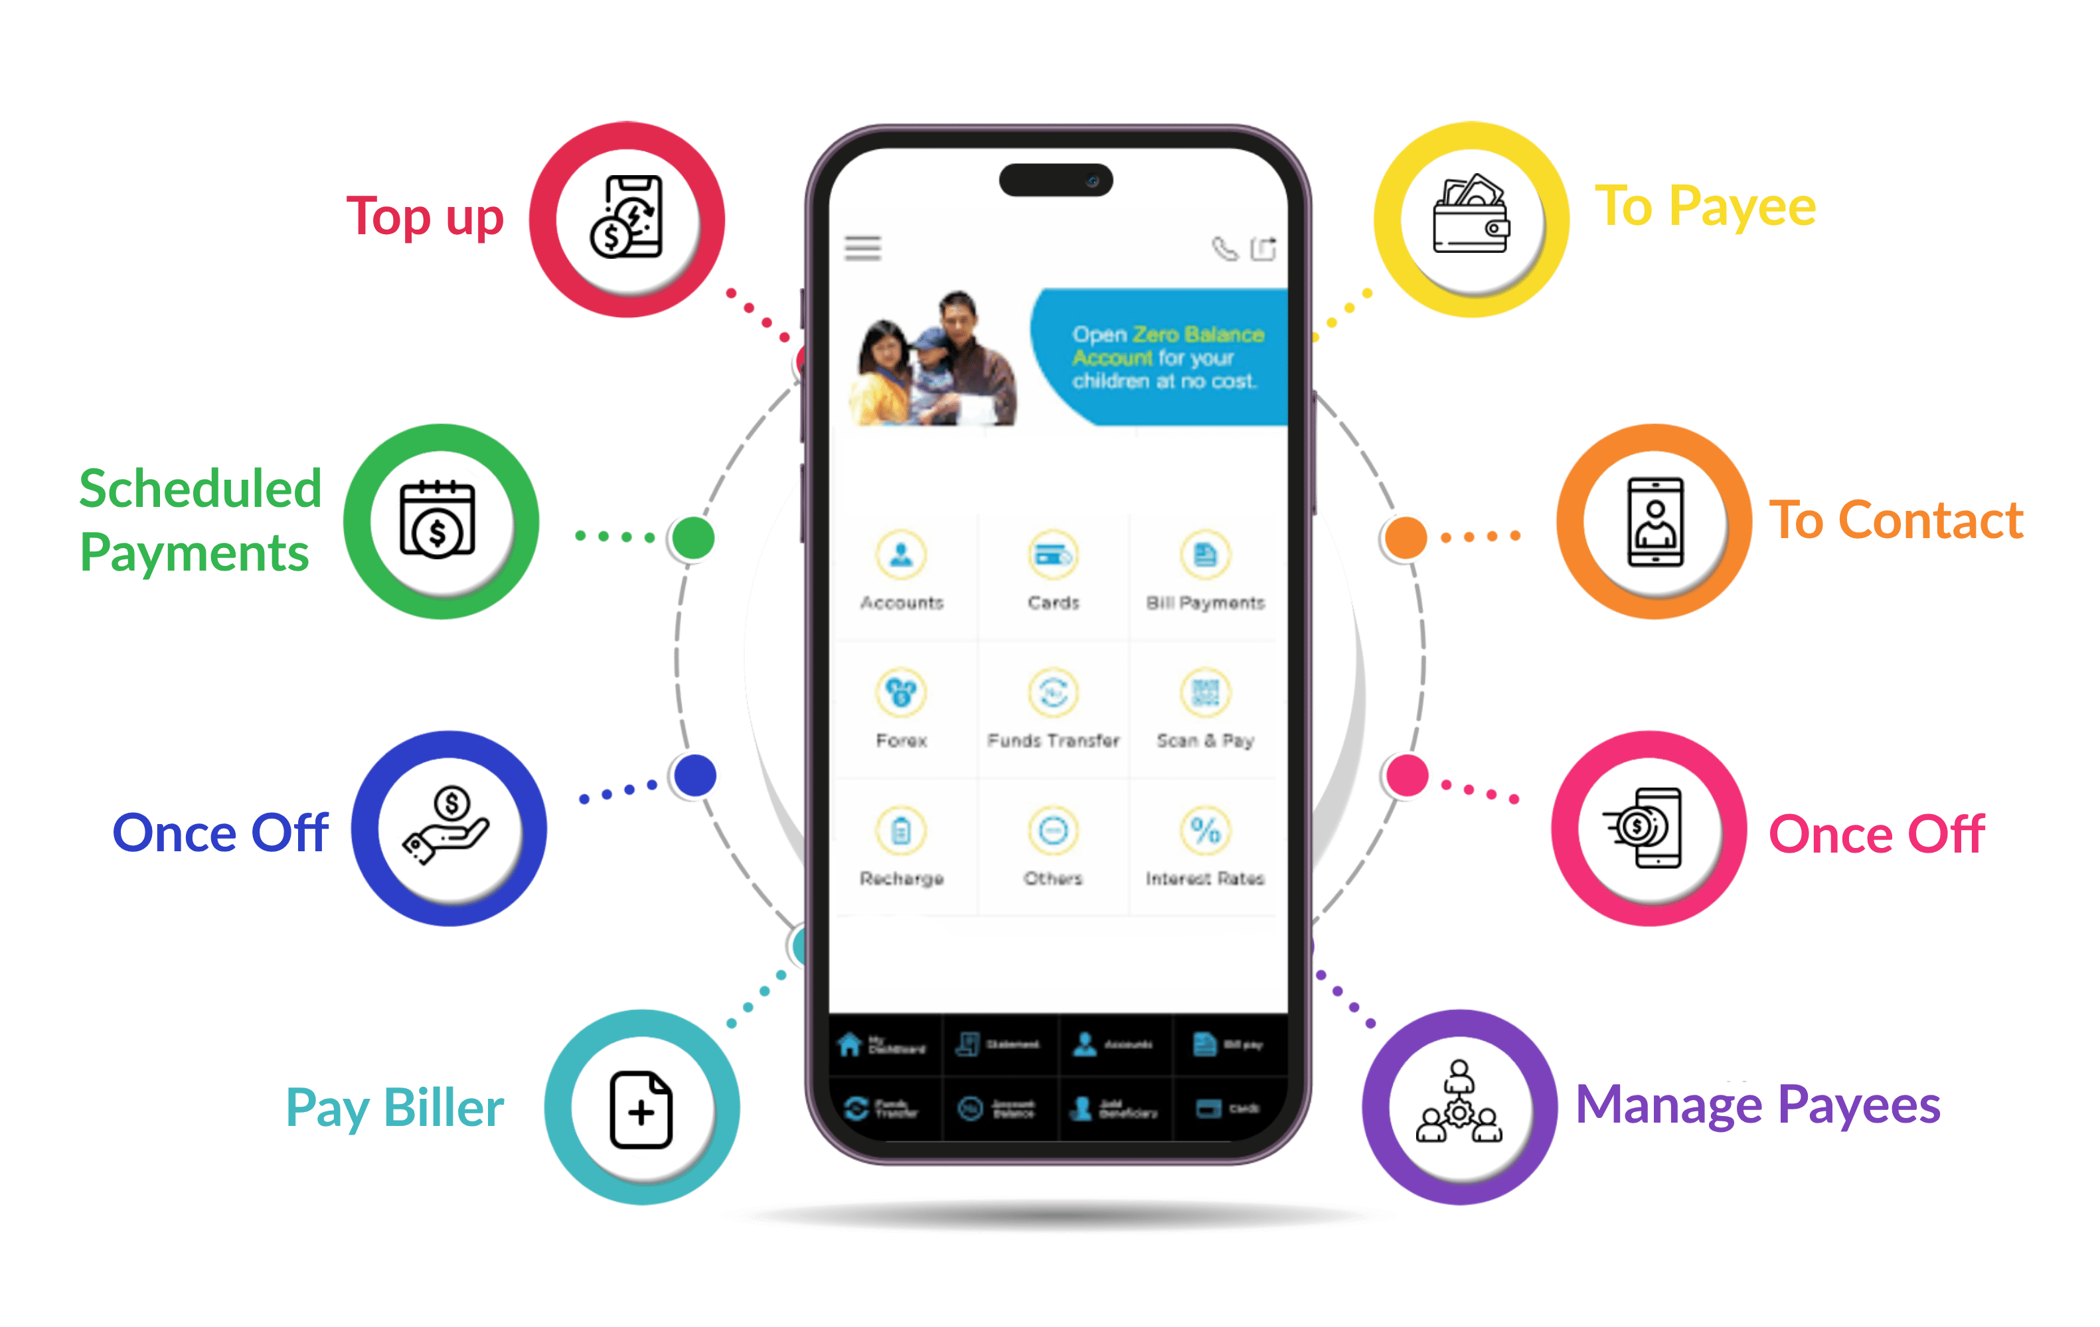
Features Overview
User Registration & Login
Secure PIN Validation & Reset
Send Money / Cash In / Cash Out
Mobile Recharge for BD Operators
Merchant Payment
Account Management
Data persistence through CSV files
Brute-force protection & validation checks

Slide 6
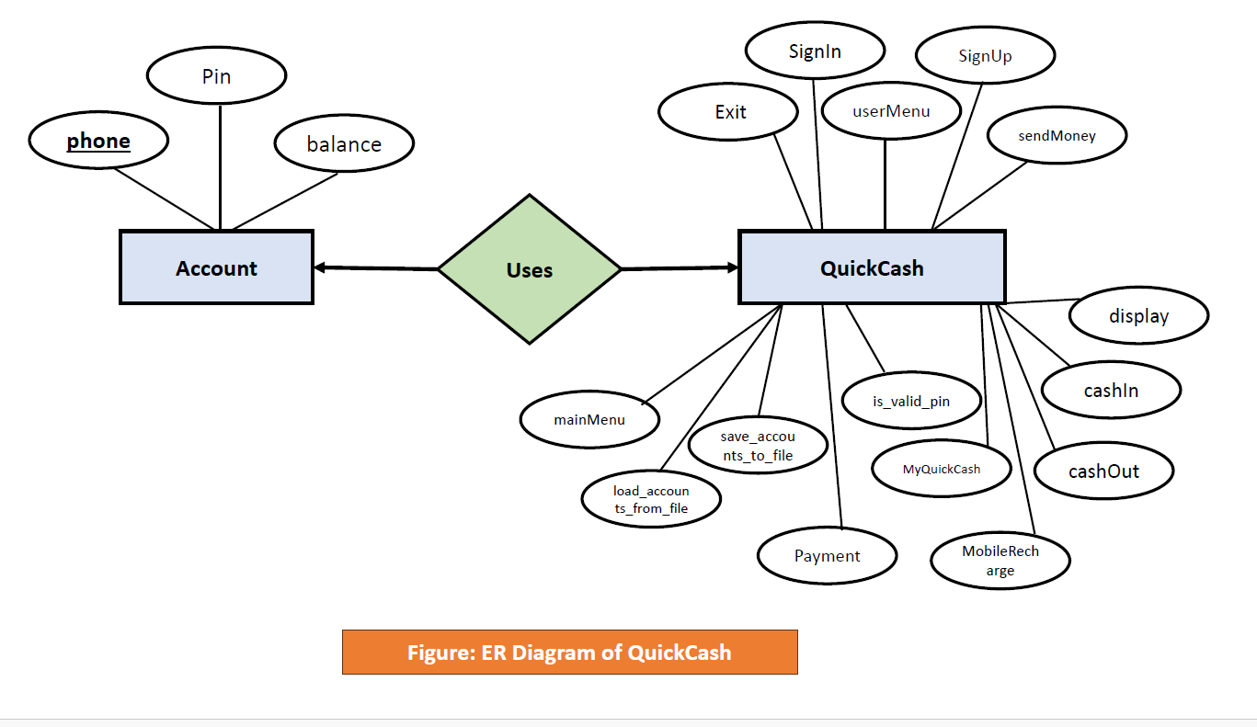
ER Diagram

Slide 7

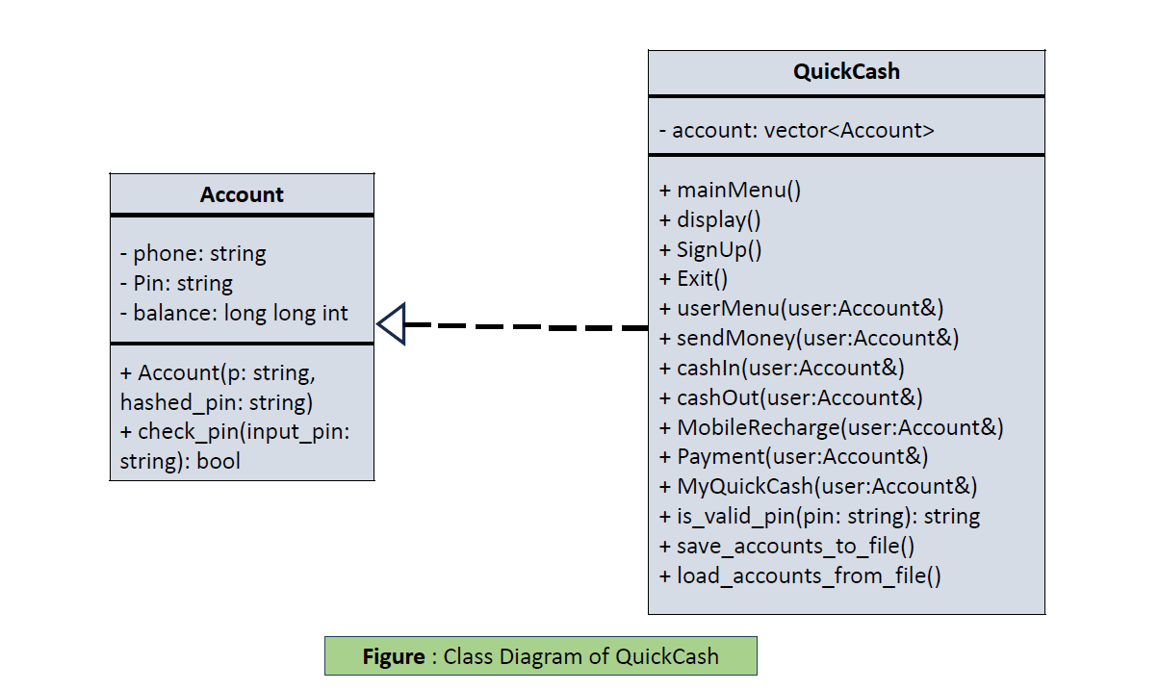

Slide 8
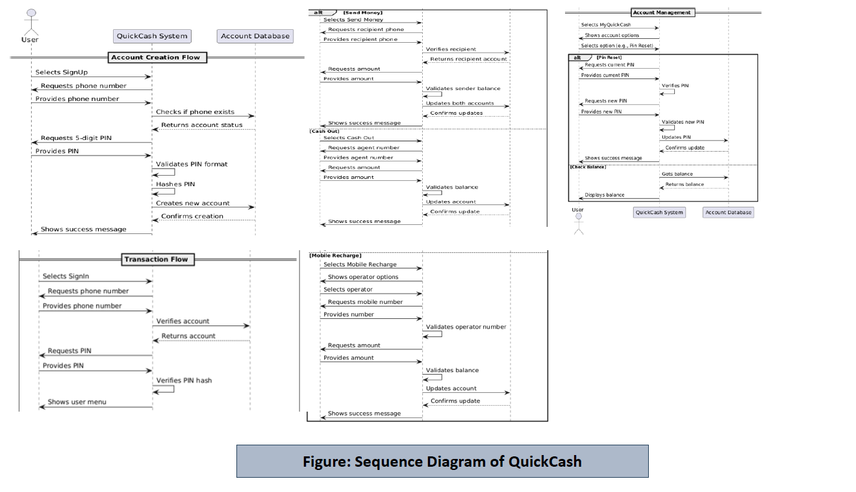
Sequence Diagram

Slide 9
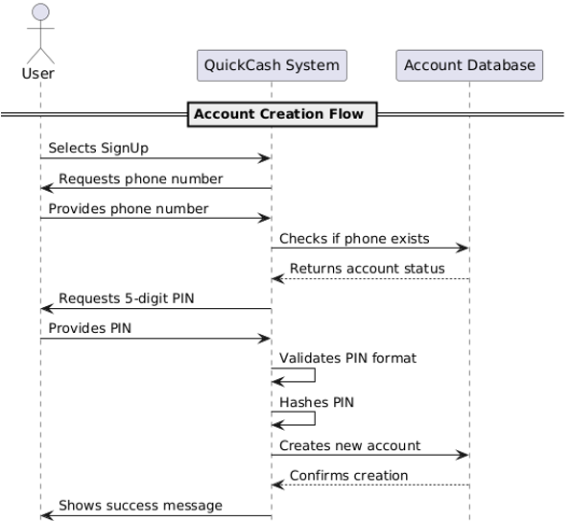
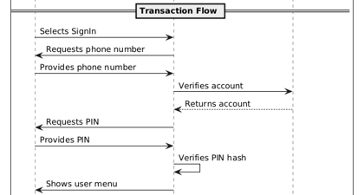

Slide 10
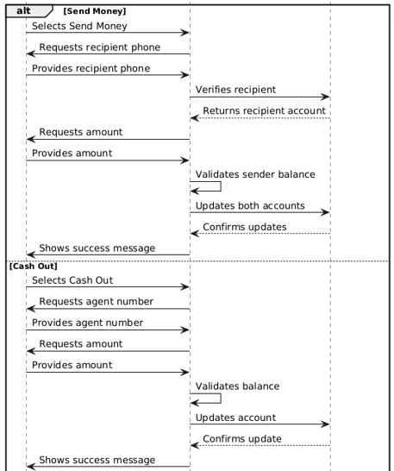
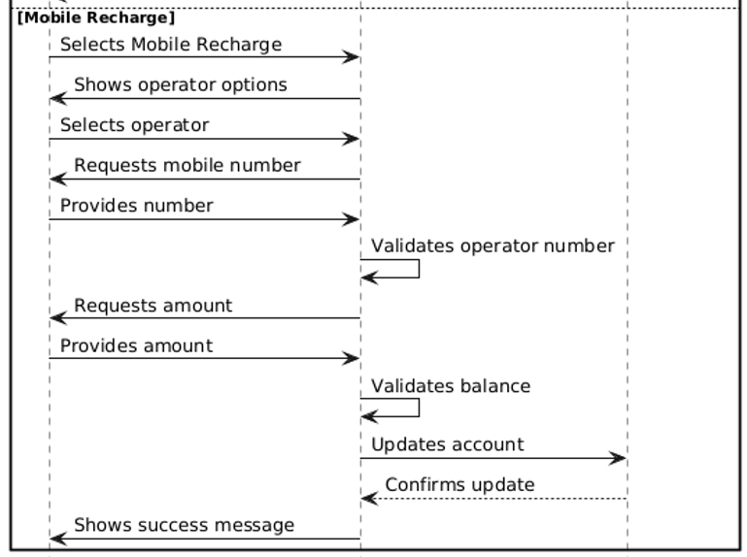

Slide 11
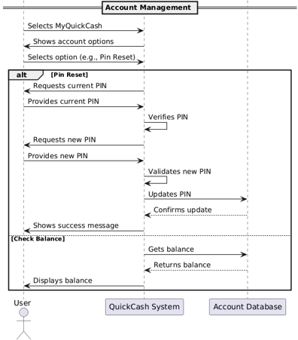

Slide 12
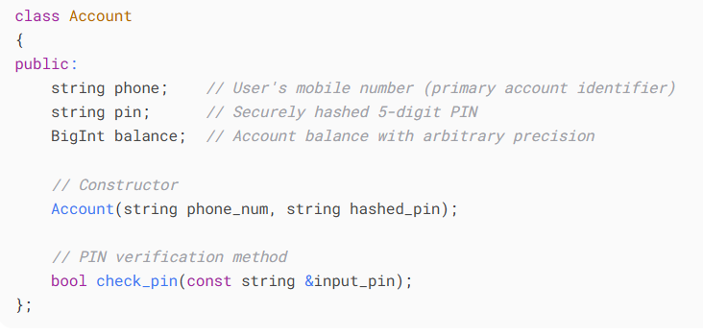
Class Implementation
Account Class:
The Account class serves as the fundamental building block of the Quick Cash system, encapsulating all essential user account information and security features. It implements core functionality for user authentication and financial management.

Slide 15
class QuickCash {
private:
vector<Account> accounts; // Stores all user accounts
public:
// Core system operations
void mainMenu();
void display();
void SignUp();
void SignIn();
void Exit();
// User operations
void userMenu(Account &user);
void sendMoney(Account &user);
void cashIn(Account &user);
void cashOut(Account &user);
void MobileRecharge(Account &user);
void Payment(Account &user);
void MyQuickCash(Account &user);
void log_out();
// Utility functions
bool is_valid_pin(const string &pin);
string hash_pin(const string &pin);
void save_accounts_to_file();
void load_accounts_from_file();
// Mobile operators
void GP(Account &user);
void Robi(Account &user);
void Airtel(Account &user);
void Teletalk(Account &user);
void Banglalink(Account &user);
// Account management
void pin_reset(Account &user);
void check_balance(Account &user);
void account_deletion(Account &user);
void customer_support(Account &user);
};
QuickCash Class
The QuickCash class serves as the main controller for the mobile banking system, managing all operations including user authentication, financial transactions, and account management. It encapsulates the core business logic and data persistence mechanisms.

Slide 16
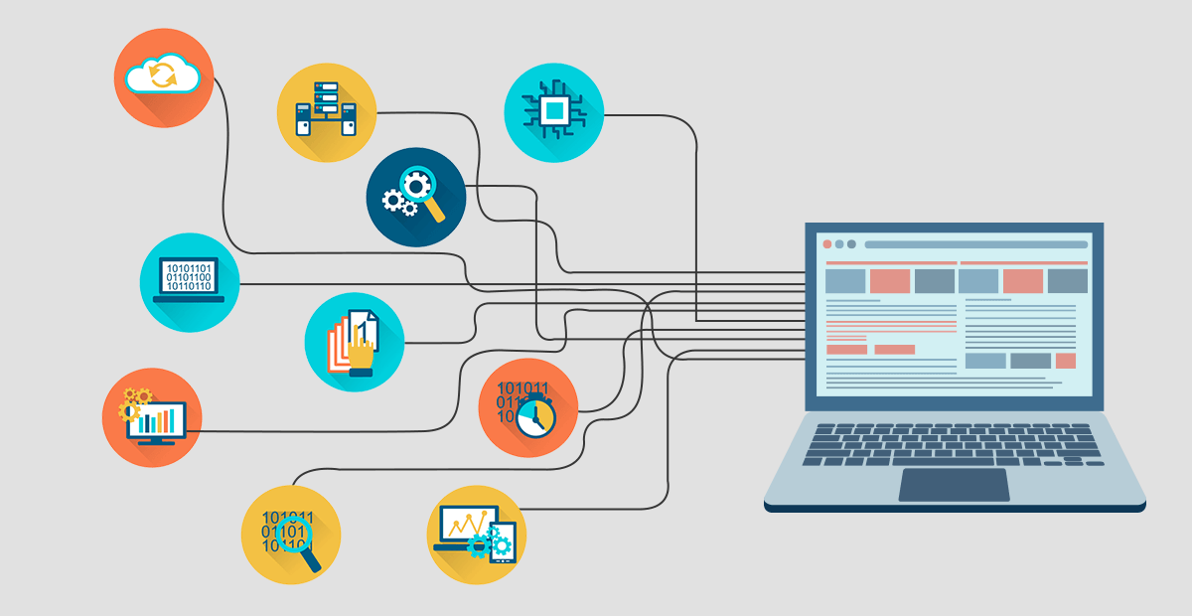
Data Management
Account Storage:
vector<Account> accounts;
Persistence:
void save_accounts_to_file();
void load_accounts_from_file();
Security Features
PIN Validation:
bool is_valid_pin(const string &pin);
Password Hashing:
string hash_pin(const string &pin);

Slide 17
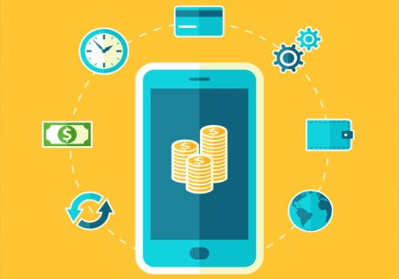
Transaction System
Money Transfer:
void sendMoney(Account &user);
2. Cash Operations:
void cashIn(Account &user);
void cashOut(Account &user);
3. Mobile Recharge:
void MobileRecharge(Account &user);

Slide 18
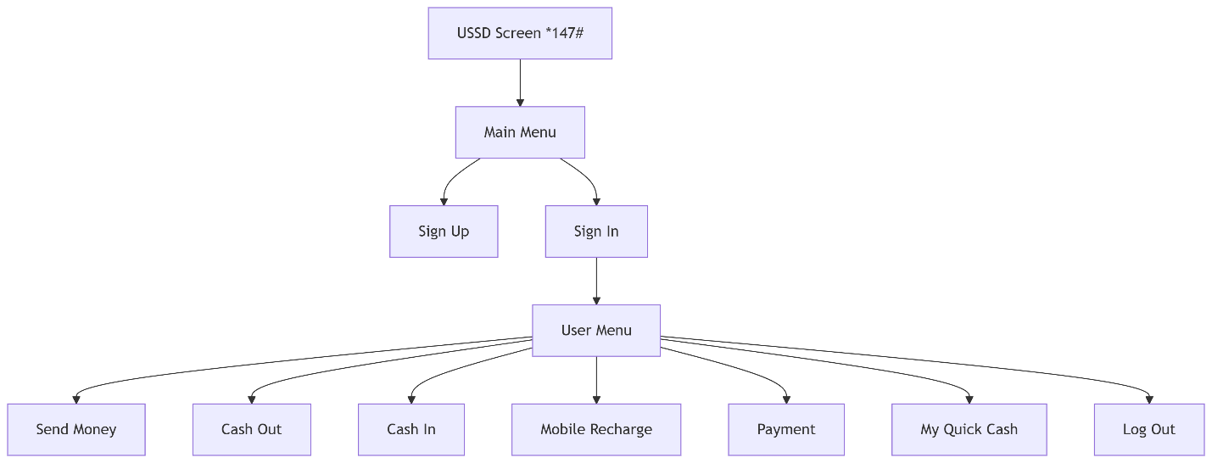
User Interface Flow

Slide 19
File Storage Format
phone,hashed_pin,balance
017XXXXXXXX,a59b9...e3f2,1500
019XXXXXXXX,c45d2...f8a1,5000

Slide 20
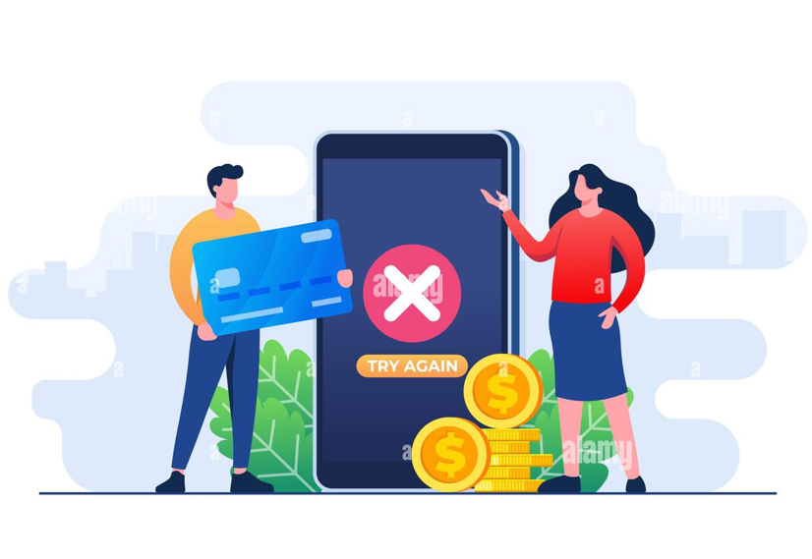
Bug Report

Slide 21
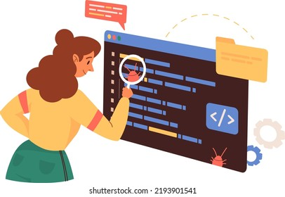

Slide 22
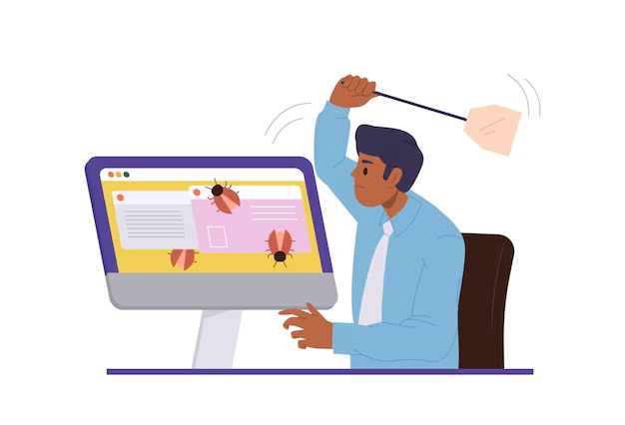

Slide 23
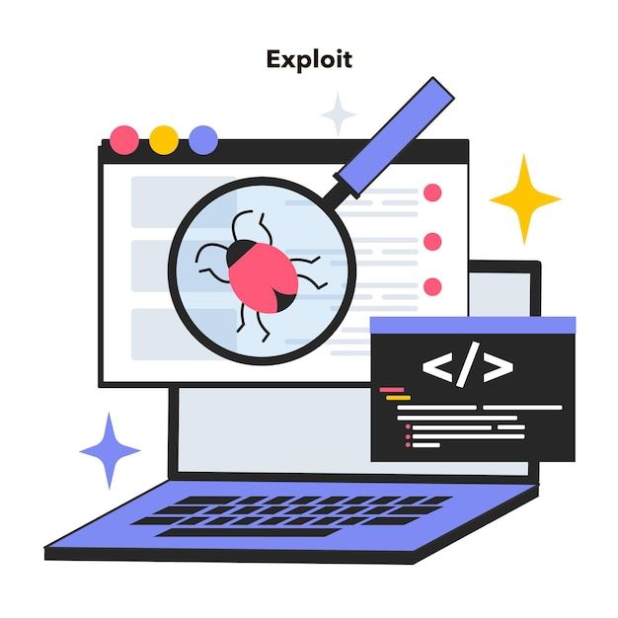

Slide 24


Slide 25


Slide 26

Summary
C++-based mobile wallet system (like bKash/Nagad)
Features: Send Money, Cash In/Out, Mobile Recharge, Account Management
Secure login with SHA-256 PIN hashing
Data saved using CSV & BigInt for accuracy
Fixed 15+ bugs and ensured strong validation
Built with OOP, file I/O, hashing & error handling
Learned secure coding, debugging & financial logic

Slide 27
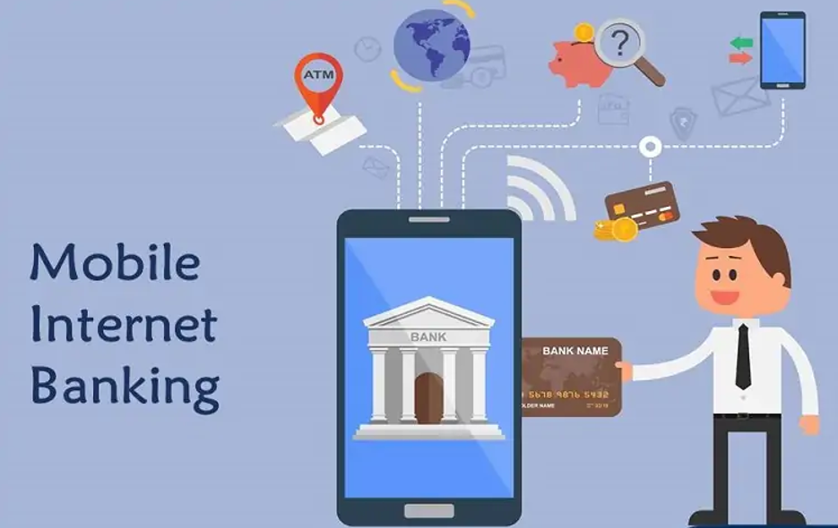
Conclusion
The Quick Cash System serves as both an educational demonstration of software engineering principles and a foundation for building more sophisticated financial applications. While meeting all core requirements, the project also highlights opportunities for expansion into a fully-featured digital banking solution.

Slide 28

📚 References & Credits
🔧 Tools & Libraries: picosha2, BigInt, VS Code, Git, Canva, MS Word
📖 Learning Resources: W3Schools, GeeksforGeeks, Stack Overflow, cppreference
💡 Inspiration: bKash, Nagad, GitHub projects
🙏 Special Thanks: Course Instructor, Lab Assistants, Reviewers, ChatGPT, DeepSeek
📦 Software Used: VS Code, GitHub, MS Office, Canva

Slide 29

Thank you!
- From GROUP C
.
+91 620 421 838

